Slide 1

Digital Image Processing, 3rd ed.
Chapter 4
Filtering in the Frequency Domain
Dept. Computer Science & Engineering
Hongtao Lu
10/25/2016

Slide 2
Outline
The 1-D Fourier Transform
Basic background of Fourier Series
1-D Fourier Transform
1-D Sampling, Aliasing, and Convolution
1-D Discrete Fourier Transform (DFT)
The 2-D Fourier Transform
2-D DFT and Its Inverse
2-D Sampling, Aliasing, and Convolution
Applications
Image Smoothing Using Frequency Domain Filters
Image Sharpening Using Frequency Domain Filters
……

Slide 3
4.1 Background
Figure 4.1 The function at the bottom is the sum of the four functions above it. Fourier’s idea in 1807 that periodic functions could be represented as a weighted sum of sines and cosines was met with skepticism.

Slide 4
4.2 Preliminary Concepts
Fourier series
(4.2-6)
where
(4.2-7)
Eq. (4.2-6) is an expansion of sines and cosines follows from Euler’s formula

Slide 5
4.2.3 Impulses and Their Sifting Property
The unit continuous impulse
(4.2-8a)
s.t.
Sifting property
More generally

Slide 6
4.2.3 Impulses and Their Sifting Property
The unit discrete impulse
(4.2-11a)
s.t.
Sifting property
More generally

Slide 7
4.2.3 Impulses and Their Sifting Property
Figure 4.2 A unit discrete impulse located at x = x₀. Variable x is discrete, and δ is 0 everywhere except at x = x₀.

Slide 8
4.2.3 Impulses and Their Sifting Property
Impulse train (脉冲序列)
(4.2-14)
Figure 4.3 An impulse train.

Slide 9
4.2.4 The Fourier Transform of Functions of One Continuous Variable
(4.2-16)
The inverse Fourier transform given F(μ):
Using Euler’s formula, (4.2-16) can be expressed as:
(4.2-17)
(4.2-18)

Slide 10
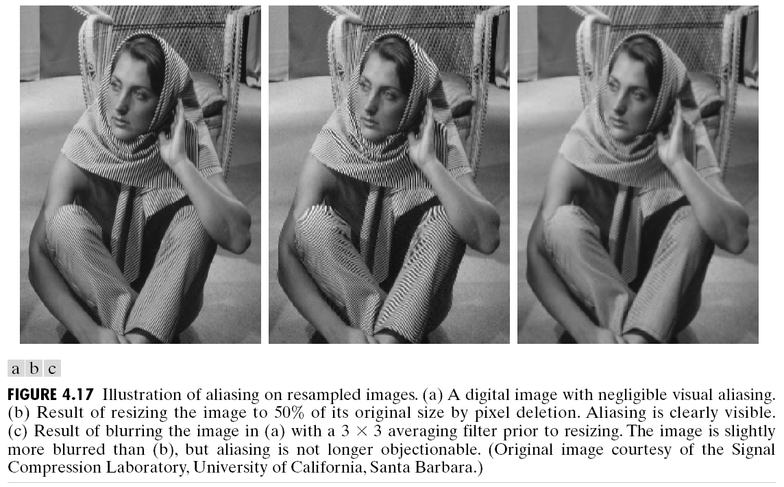
4.2.4 The Fourier Transform of Functions of One Continuous Variable
Fourier spectrum (or frequency spectrum)
Figure 4.4 (a) A simple function; (b) its Fourier transform;
(c) the spectrum. All functions extend to infinity in both directions.

Slide 11
4.2.5 Convolution
Convolution (of two continuous functions)
Convolution theorem
(4.2-20)
(4.2-21)
(4.2-22)

Slide 12
4.3 Sampling and the Fourier Transform of Sampled Functions
4.3.1 Sampling
The value of each sample in the sequence is given by
for any integer value k = …, -2, -1, 0, 1, 2, …
(4.3-1)
(4.3-2)

Slide 13
Figure 4.5
(a) A continuous function. (b) Train of impulses used to model the sampling process. (c) Sampled function formed as the product of (a) and (b). (d) Sample values obtained by integration and using the sifting property of the impulse. (The dashed line in (c) is shown for reference. It is not part of the data.)

Slide 14
4.3 Sampling and the Fourier Transform of Sampled Functions
4.3.2 The Fourier Transform of Sampled Functions
(4.3-5)

Slide 15
Figure 4.6
(a) Fourier transform of a band-limited function.
(b)-(d) Transforms of the corresponding sampled function under the conditions of over-sampling, critically-sampling, and under-sampling, respectively.

Slide 16
4.3 Sampling and the Fourier Transform of Sampled Functions
4.3.3 The Sampling Theorem
Figure 4.7
(a) Transform of a band-limited function. (b) Transform resulting from critically sampling the same function.
sufficient separation is guaranteed if

Slide 17
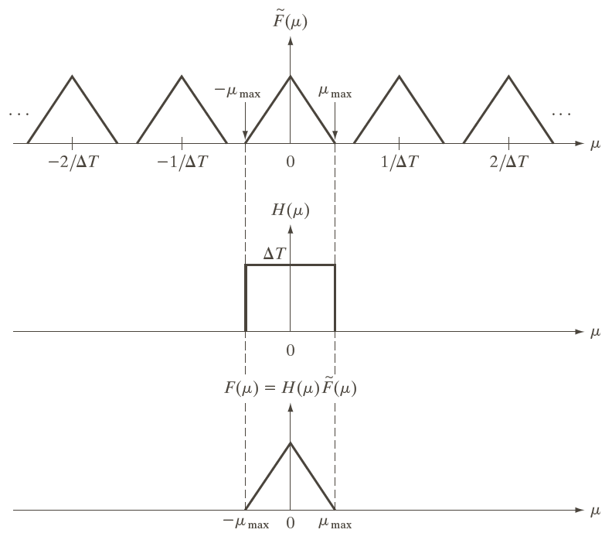
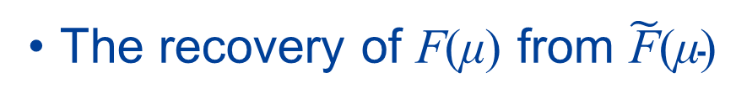
The recovery of F(μ) from $\tilde{\text{F}}\text{(}\text{μ}\text{)}$
Figure 4.8
Extracting one period of the transform of a band-limited function using an ideal lowpass filter.
H(μ) is called a lowpass filter

Slide 18
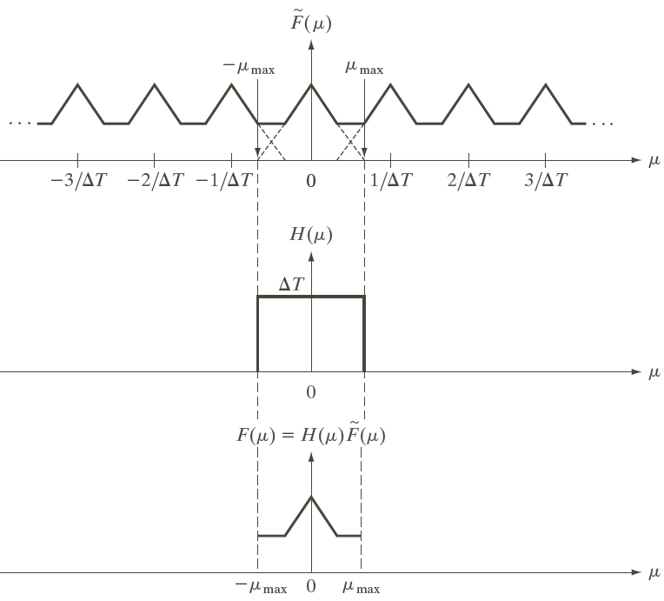
4.3.4 Aliasing
Figure 4.9
(a) Fourier transform of an under-sampled, band-limited function. (Interference from adjacent periods is shown dashed in this figure).
(b) The same ideal lowpass filter used in Fig. 4.8(b).
(c) The product of (a) and (b).

Slide 19
4.3 Sampling and the Fourier Transform of Sampled Functions
4.3.4 Aliasing
Figure 4.10 Illustration of aliasing. The under-sampled function (black dots) looks like a sine wave having a frequency much lower than the frequency of the continuous signal.

Slide 20
4.4 The Discrete Fourier Transform (DFT) of One Variable
1-D DFT pair
u = 0,1,2, ..., M – 1
(4.4-6)
x = 0,1,2, ..., M – 1
(4.4-7)

Slide 21
4.4 The Discrete Fourier Transform (DFT) of One Variable
Both the forward and inverse DFT are infinitely periodic, with period M.
Circular convolution
(4.4-8)
(4.4-9)
(4.4-10)

Slide 22
The mechanics of computing the DFT
Figure 4.11 (a) A function, and (b) samples in the x-domain.
e.g.,

Slide 23
4.5 Extension to Functions of Two Variables
4.5.1 The 2-D Impulse and Its Sifting Property
Figure 4.12 Two-dimensional unit discrete impulse.

Slide 24
4.5 Extension to Functions of Two Variables
4.5.2 The 2-D Continuous Fourier Transform Pair
The magnitude (spectrum) is given by
(4.5-7)
(4.5-8)

Slide 25
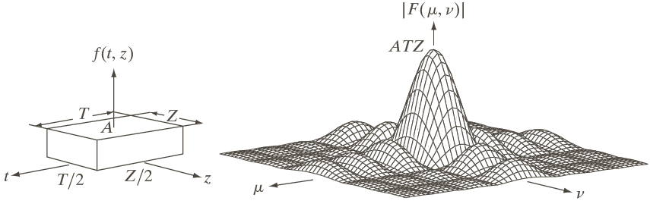
4.5 Extension to Functions of Two Variables
Figure 4.13 (a) A 2-D function, and (b) a section of its spectrum (not to scale).

Slide 26
4.5 Extension to Functions of Two Variables
2-D sampling function (2-D impulse train)
(4.5-9)
Figure 4.14
Two-dimensional impulse train.

Slide 27
4.5 Extension to Functions of Two Variables
The 2-D sampling theorem
and
or
and

Slide 28
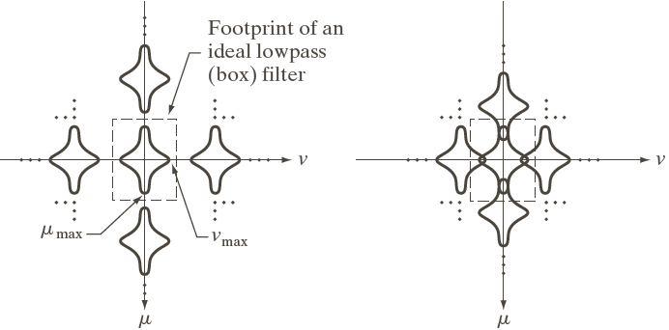
4.5 Extension to Functions of Two Variables
Figure 4.15
Two-dimensional Fourier transforms of (a) an over-sampled, and (b) under-sampled band-limited function.

Slide 29
4.5.4 Aliasing in images
Figure 4.16 Aliasing in images. In (a) and (b), the lengths of the sides of the squares are 16 and 6 pixels, respectively, and aliasing is visually negligible. In (c) and (d), the sides of the squares are 0.9174 and 0.4798 pixels, respectively, and the results show significant aliasing.

Slide 30
4.5.4 Aliasing in resampled images
Figure 4.17 Illustration of aliasing on resampled images. (a) A digital image with negligible visual aliasing. (b) Result of resizing the image to 50% of its original size by pixel deletion. Aliasing is clearly visible. (c) Result of blurring the image in (a) with a 3 x 3 averaging filter prior to resizing.

Slide 31
4.5.4 Jaggies (锯齿) in image shrinking
Figure 4.18 Illustration of jaggies. (a) A 1024 x 1024 digital image of a computer-generated scene with negligible visible aliasing. (b) Result of reducing (a) to 25% of its original size using bilinear interpolation.
(c) Result of blurring the image in (a) with a 5 x 5 averaging filter prior to resizing it to 25% using bilinear interpolation.

Slide 32
4.5.4 Jaggies in image zooming
Figure 4.19 Image zooming. (a) A 1024 x 1024 digital image generated by pixel replication from a 256 x 256 image extracted from the middle of Fig. 4.18(a). (b) Image generated using bi-linear interpolation, showing a significant reduction in jaggies.

Slide 33
4.5.4 Moiré patterns (莫尔条纹)
Figure 4.20 Examples of the moiré effect. These are ink drawings, not digitized patterns. Superimposing one pattern on the other is equivalent mathematically to multiplying the patterns.

Slide 34
Figure 4.21
A newspaper image of size 246 x 168 pixels sampled at 75 dpi showing a moiré pattern. The moiré pattern in this image is the interference pattern created between the ±45° orientation of the halftone dots and the north-south orientation of the sampling grid used to digitize the image.

Slide 35
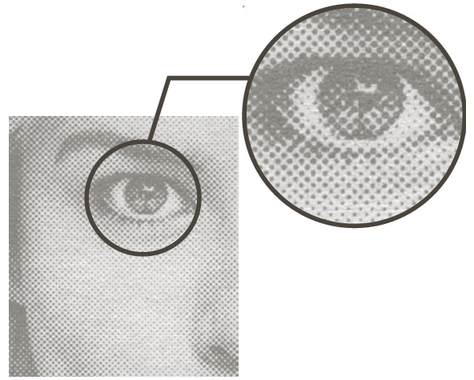
Figure 4.22
A newspaper image and an enlargement showing how halftone dots are arranged to render shades of gray.

Slide 36
4.5 Extension to Functions of Two Variables
The 2-D discrete Fourier transform (2-D DFT) pair
(4.5-15)
(4.5-16)

Slide 37
4.6 Some Properties of the 2-D DFT
Translation
Rotation
Periodicity
(4.6-3)
(4.6-4)
(4.6-5)

Slide 38
Figure 4.23
Centering the Fourier transform. (a) A 1-D DFT showing an infinite number of periods. (b) Shifted DFT obtained by multiplying f (x) by (-1)^{x} before computing F(u). (c) A 2-D DFT showing an infinite number of periods. The solid area is the M × N data array, F(u, v), obtained with Eq. (4.5-15). This array consists of four quarter periods. (d) A shifted DFT obtained by multiplying f (x, y) by (-1)^{x+y} before computing F(u, v).

Slide 39
4.6.4 Symmetry Properties

Slide 40
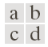
4.6.5 Fourier Spectrum and Phase Angle
Figure 4.24
(a) Image. (b) Spectrum showing bright spots in the four corners.
(c) Centered spectrum. (d) Results showing increased detail after a long transformation.

Slide 41
4.6.5 Fourier Spectrum and Phase Angle
Figure 4.25
(a) The rectangle in Fig. 4.24(a) translated, and (b) the corresponding spectrum.
(c) Rotated rectangle, and
(d) the corresponding spectrum.

Slide 42
4.6.5 Fourier Spectrum and Phase Angle
Figure 4.26 Phase angle array corresponding (a) to the image of the centered rectangle in Fig. 4.24(a), (b) to the translated image in Fig. 4.25(a), and (c) to the rotated image in Fig. 4.25(c).

Slide 43
Figure 4.27 Further illustration of the properties of the Fourier spectrum and phase angle.

Slide 44
4.6.6 The 2-D Convolution Theorem
2-D circular convolution
for x = 0,1,2, ..., M – 1 and y = 0,1,2, …, N – 1.
The 2-D convolution theorem
(4.6-23)
(4.6-24)
(4.6-25)

Slide 45
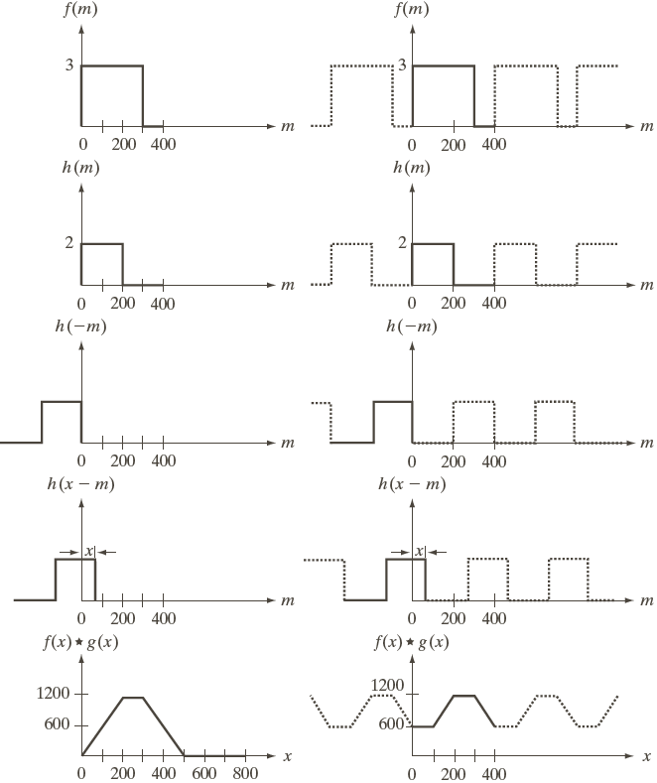
Figure 4.28
Left column: convolution of two discrete functions obtained using the approach discussed in Section 3.4.2. The result in (e) is correct.
Right column: Convolution of the same functions, but taking into account the periodicity implied by the DFT.

Slide 46
4.6.7 Summary of 2-D DFT definitions and corresponding expressions
1) DFT of
2) IDFT of
3) Polar representation
4) Spectrum
R = Real(F); I = Imag(F)
(Continued)

Slide 47
5) Phase angle
6) Power spectrum
7) Average value
8) Periodicity (k₁ and
k₂ are integers)
(Continued)

Slide 48
9) Convolution
10) Correlation
☆
11) Separability (See Section 4.11.1)
12) Obtaining the inverse Fourier transform using a forward
transform algorithm. (See Section 4.11.2)

Slide 49
4.6.7 Summary of 2-D DFT Pairs
1) Symmetry properties (See the last three slides)
2) Linearity
3) Translation (general)
4) Translation to center of the frequency rectangle, (M/2, N/2)
(Continued)

Slide 50
5) Rotation
6) Convolution theorem
7) Correlation theorem
☆
☆
8) Discrete unit impulse
9) Rectangle
(Continued)

Slide 51
10) Sine
11) Cosine
12) Differentiation (assume that f (±∞, ±∞) = 0.)
13) Gaussian
(A is a constant)

Slide 52
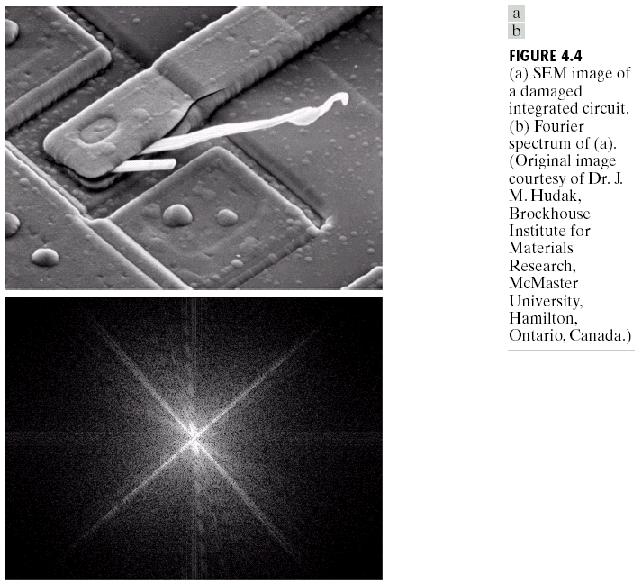
4.7 The Basics of Filtering in the Frequency Domain
Figure 4.29 (a) SEM image of a damaged integrated circuit. (b) Fourier spectrum of (a).

Slide 53
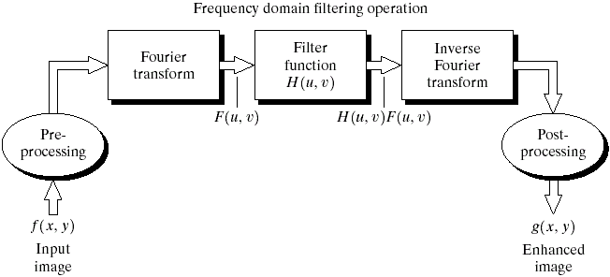
4.7 The Basics of Filtering in the Frequency Domain
Basic steps for filtering in the frequency domain
(4.7-1)

Slide 54
4.7 The Basics of Filtering in the Frequency Domain
Figure 4.30 Result of filtering the image in Fig. 4.29(a) by setting to 0 the term F(M/2, N/2) in the Fourier transform.

Slide 55
Figure 4.31 Top row: frequency domain filters.
Bottom row: corresponding filtered images.

Slide 56
4.7 The Basics of Filtering in the Frequency Domain
Figure 4.32 (a) A simple image. (b) Result of blurring with a Gaussian lowpass filter without padding. (c) Result of lowpass filtering with padding. Compare the light area of the vertical edges in (b) and (c).

Slide 57
4.7 The Basics of Filtering in the Frequency Domain
Figure 4.33 2-D image periodicity inherent in using the DFT.
Periodicity without image padding.
Periodicity after padding with 0s (black).

Slide 58
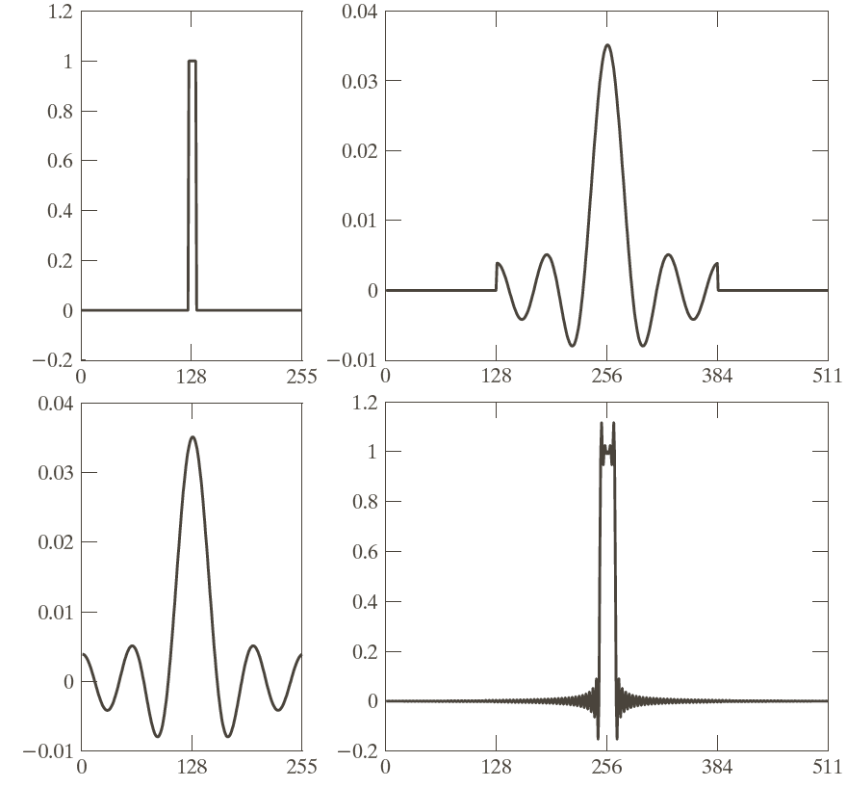
Figure 4.34
(a) Original filter specified in the (centered) frequency domain.
(b) Spatial representation obtained by computing the IDFT of (a).
(c) Result of padding (b) to twice its length (note the discontinuities).
(d) Corresponding filter in the frequency domain obtained by computing the DFT of (c).

Slide 59
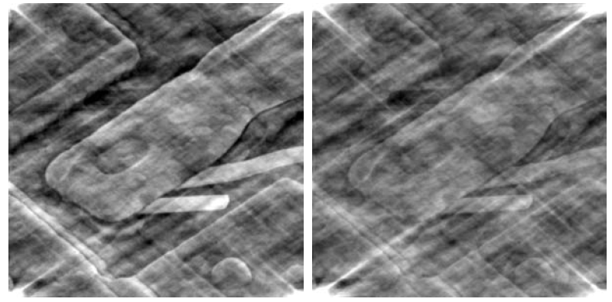
4.7 The Basics of Filtering in the Frequency Domain
Figure 4.35 (a) Image resulting from multiplying by 0.5 the phase angle in Eq. (4.6-15) and then computing the IDFT. (b) The result of multiplying the phase by 0.25.

Slide 60
Figure 4.36
(a) An M × N image, f.
(b) Padded image, f_{p} of size P × Q.
(c) Result of multiplying f_{p} by (-1)^{x+y}.
(d) Spectrum of F_{p}.
(e) Centered Gaussian lowpass filter, H, of size
P × Q.
(f) Spectrum of the product HF_{p}.
(g) g_{p,} the product of
(-1)^{x+y} and the real part of the IDFT of HF_{p}.
(h) Final result, g, obtained by cropping the first M rows and N columns of g_{p}.

Slide 61
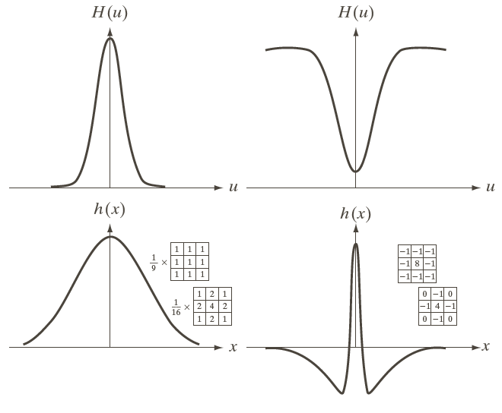
Figure 4.37
(a) A 1-D Gaussian lowpass filter in the frequency domain.
(b) Spatial lowpass filter corresponding to (a).
(c) Gaussian highpass filter in the frequency domain.
(d) Spatial highpass filter corresponding to (c).

Slide 62
4.7.4 Obtaining a frequency domain filter from a small spatial mask
Figure 4.38 (a) Image of a building, and (b) its spectrum.

Slide 63
Figure 4.39
(a) A spatial mask and perspective plot of its corresponding frequency domain filter.
(b) Filter shown as an image.
(c) Result of filtering Fig. 4.38(a) in the frequency domain with the filter in (b).
(d) Result of filtering the same image with the spatial filter in (a).

Slide 64
4.8 Image Smoothing Using Frequency Domain Filters
4.8.1 Ideal lowpass filters (ILPF)
(4.8-1)
where D₀ is a positive constant,

Slide 65
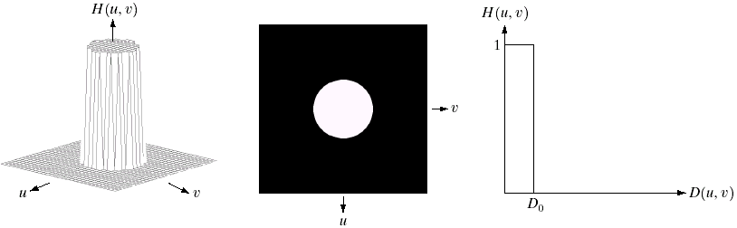
4.8 Image Smoothing Using Frequency Domain Filters
4.8.1 Ideal lowpass filters (ILPF)
Figure 4.40 (a) Perspective plot of an ideal lowpass filter transfer function. (b) Filter displayed as an image. (c) Filter radial cross section.

Slide 66
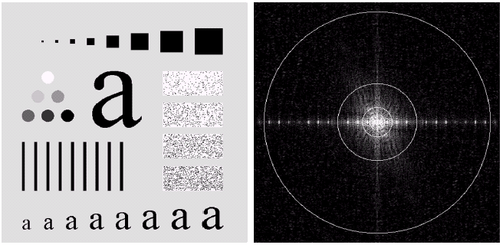
4.8.1 Image smoothing using an ILPF
Figure 4.41 (a) Test pattern of size 500 x 500 pixel, and (b) its Fourier spectrum.

Slide 67
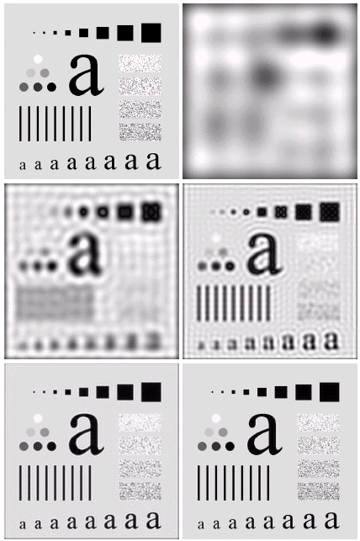
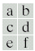
Figure 4.42
(a) Original image.
(b) - (f) Results of ideal lowpass filtering with cutoff frequencies set at radii values of 5, 15, 30, 80, and 230, as shown in Fig. 4.41(b). The power removed by these filters was 8, 5.4, 3.6, 2, and 0.5% of the total, respectively.

Slide 68
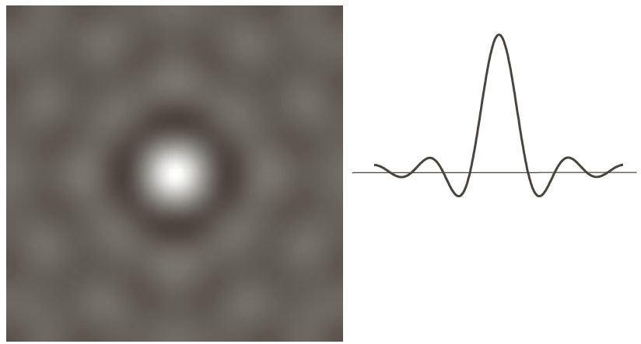
4.8.1 Image smoothing using an ILPF
Figure 4.43 (a) Representation in the spatial domain of an ILPF of radius 5 and size 1000 x 1000. (b) Intensity profile of a horizontal line passing through the center of the image.

Slide 69
4.8 Image Smoothing Using Frequency Domain Filters
4.8.2 Butterworth Lowpass Filters (BLPF)
(4.8-5)
where D₀ is the cutoff frequency from the origin

Slide 70
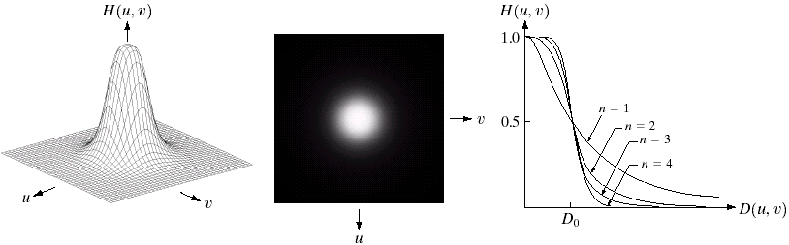
4.8 Image Smoothing Using Frequency Domain Filters
4.8.2 Butterworth Lowpass Filters (BLPF)
Figure 4.44 (a) Perspective plot of a Butterworth lowpass filter transfer function. (b) Filter displayed as an image. (c) Filter radial cross sections of orders 1 through 4.

Slide 71
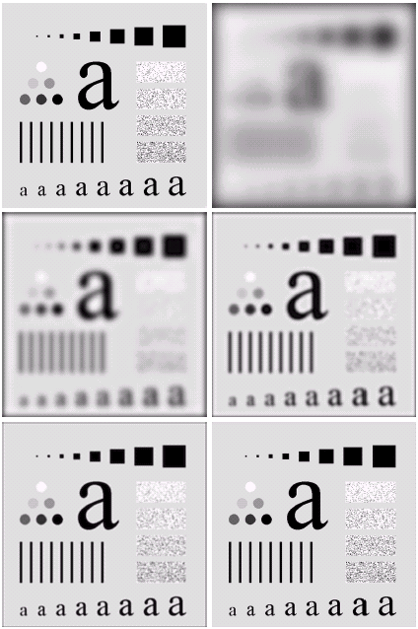
Figure 4.45
(a) Original image.
(b)-(f) Results of filtering using BLPFs of order 2, with cutoff frequencies set at radii values of 5, 15, 30, 80, and 230, as shown in Fig. 4.41(b).
Compare with Fig. 4.42.

Slide 72
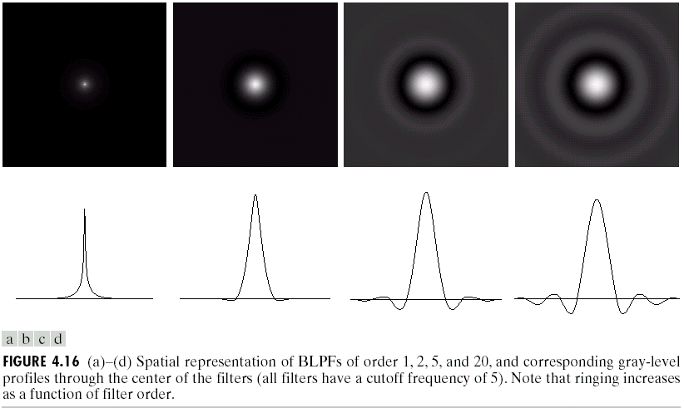
4.8.2 Image smoothing with a BLPF
Figure 4.46 (a)-(d) Spatial representation of BLPFs of order 1, 2, 5, and 20, and corresponding gray-level profiles through the center of the filters (all filters have a cutoff frequency of 5).

Slide 73
4.8 Image Smoothing Using Frequency Domain Filters
4.8.3 Gaussian Lowpass Filters (GLPF)
(4.8-7)
where D₀ is the cutoff frequency from the origin

Slide 74
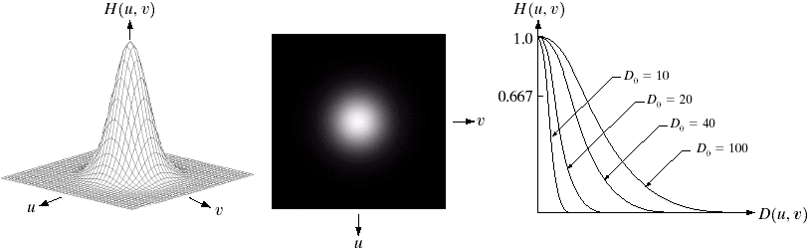
4.8 Image Smoothing Using Frequency Domain Filters
4.8.3 Gaussian Lowpass Filters (GLPF)
Figure 4.47 (a) Perspective plot of a GLPF transfer function.
(b) Filter displayed as an image. (c) Filter radial cross sections for various values of D₀.

Slide 75
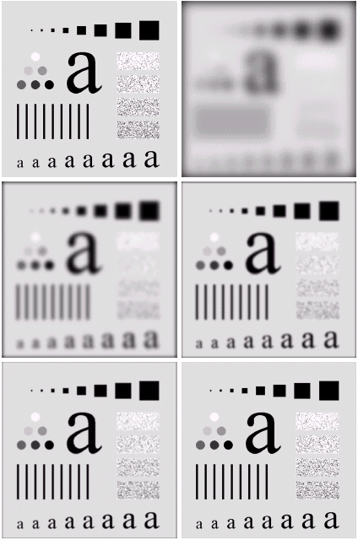
Figure 4.48
(a) Original image.
(b) - (f) Results of filtering using GLPFs with cutoff frequencies set at radii values of 5, 15, 30, 80, and 230, as shown in Fig. 4.41(b).
Compare with Fig. 4.42 and Fig. 4.45.

Slide 76
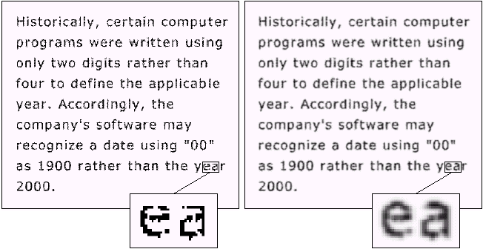
4.8.2 Image smoothing with a GLPF
Figure 4.49 (a) Sample text of poor resolution (note broken characters in magnified view). (b) Result of filtering with a GLPF (broken character segments were joined).

Slide 77
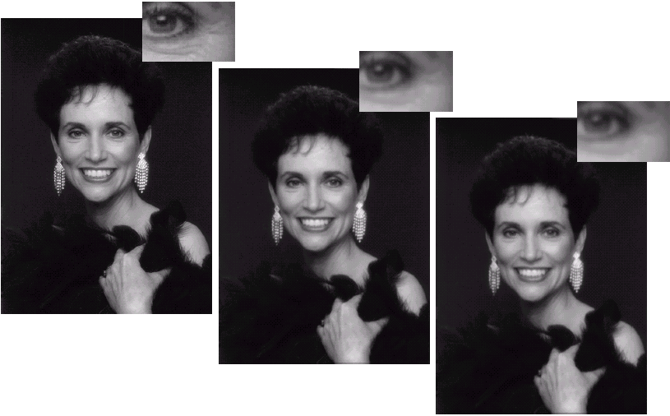
Figure 4.50 (a) Original image (1028 x 732 pixels). (b) Result of filtering with a GLPF with D₀ = 100.
(c) Result of filtering with a GLPF with D₀ = 80.

Slide 78
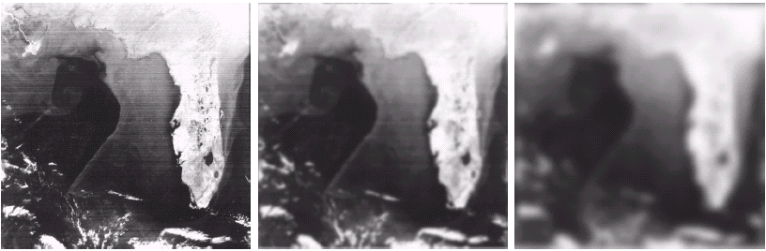
4.8.2 Image smoothing with a GLPF
Figure 4.51 (a) Image showing prominent scan lines. (b) Result of filtering using a GLPF with D₀ = 30. (c) Result of using a GLPF with D₀ = 10.

Slide 79
4.9 Image Sharpening Using Frequency Domain Filters
A highpass filter
(4.9-1)
Ideal highpass filters (IHPF)
(4.9-2)

Slide 80
4.9 Image Sharpening Using Frequency Domain Filters
Butterworth highpass filters (BHPF)
(4.9-3)
Gaussian highpass filters (GHPF)
(4.9-4)

Slide 81
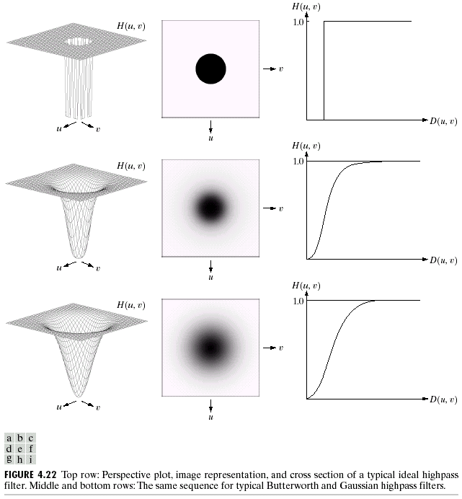
Figure 4.52
Top row: Perspective plot, image representation, and cross section of a typical ideal highpass filter. Middle and bottom rows: The same sequence for typical Butterworth and Gaussian highpass filters.

Slide 82
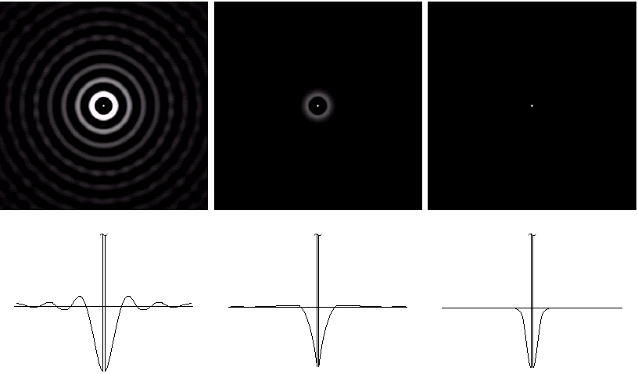
Figure 4.53 Spatial representation of typical (a) ideal,
(b) Butterworth, and (c) Gaussian frequency domain highpass filters, and corresponding gray-level profiles.

Slide 83
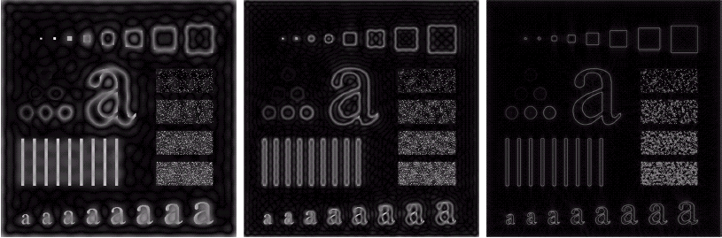
Figure 4.54 Results of ideal highpass filtering the image in Fig. 4.41(a) with D₀ = 15, 30, and 80, respectively. Problems with ringing are quite evident in (a) and (b).

Slide 84
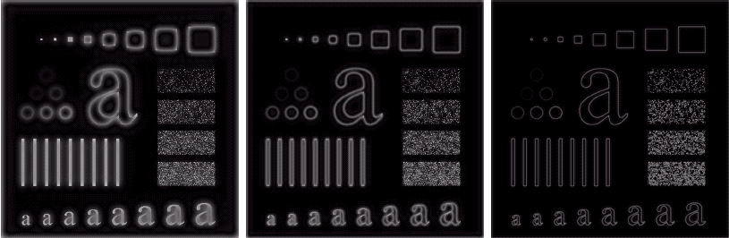
Figure 4.55 Results of highpass filtering the image in Fig. 4.41(a) using a BHPF of order 2 with D₀ = 15, 30, and 80, respectively. These results are much smoother than those obtained with an ILPF.

Slide 85
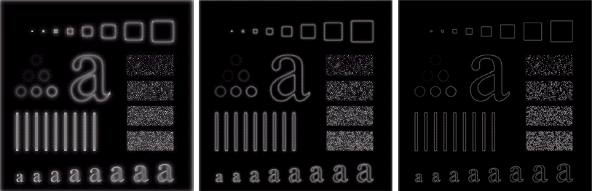
Figure 4.56 Results of highpass filtering the image in Fig. 4.41(a) using a GHPF of order 2 with D₀ = 15, 30, and 80, respectively.
Compare with Figs. 4.54 and 4.55.

Slide 86
4.9 Image Sharpening Using Frequency Domain Filters
Using highpass filtering and thresholding for image enhancement
Figure 4.57 (a) Thumb print. (b) Result of highpass filtering (a). (c) Result of thresholding (b).

Slide 87
4.9.4 The Laplacian in the Frequency Domain
Implement Laplacian in the frequency domain
(4.9-5)
or, with respect to the center of the frequency rectangle
(4.9-6)
The Laplacian image is obtained as:
(4.9-7)

Slide 88
4.9.4 The Laplacian in the Frequency Domain
Image enhancement is achieved using
(4.9-8)
In the frequency domain
(4.9-9)

Slide 89
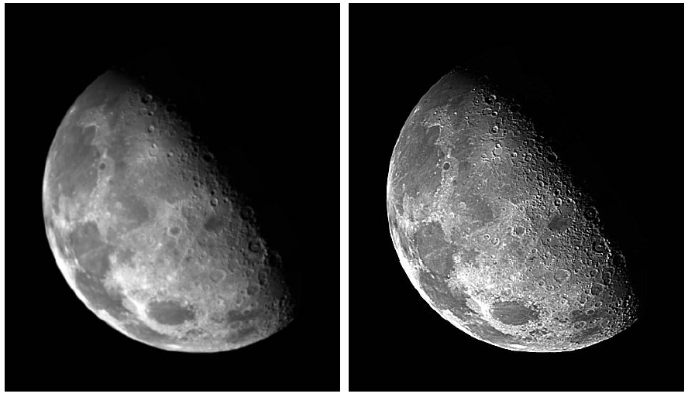
4.9.4 The Laplacian in the Frequency Domain
Image sharpening in the frequency domain using the Laplacian.
Figure 4.58
(a) Original, blurry image.
(b) Image enhanced using the Laplacian in the frequency domain.

Slide 90
4.9.5 Unsharp Masking, Highboost Filtering, and High-Frequency-Emphasis Filtering
(4.9-10)
(4.9-11)
(4.9-12)
k = 1, unsharp masking; k > 1, highboost filtering

Slide 91
4.9.5 Unsharp Masking, Highboost Filtering, and High-Frequency-Emphasis Filtering
Express g(x, y) in terms of a lowpass filter:
(4.9-13)
Express g(x, y) in terms of a highpass filter:
(4.9-14)
The expression contained within the square brackets is called high-frequency-emphasis filter.

Slide 92
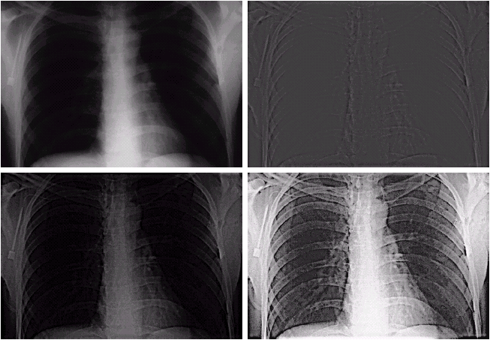
Figure 4.59 (a) A chest X-ray image. (b) Result of Butterworth highpass filtering. (c) Result of high-frequency-emphasis filtering. (d) Result of performing histogram equalization on (c).

Slide 93
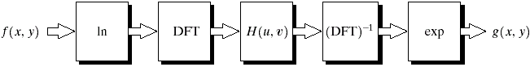
4.9.6 Homomorphic Filtering (同态滤波)
Homomorphic systems
Figure 4.60 Summary of steps in homomorphic filtering approach for image enhancement.

Slide 94
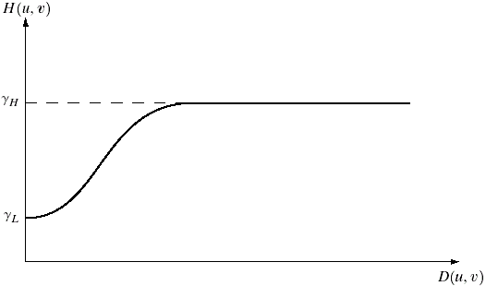
4.9.6 Homomorphic Filtering (同态滤波)
Homomorphic filter function
(4.9-29)
Figure 4.61
Radial cross section of a circularly symmetric homomorphic filter function.

Slide 95
4.9.6 Image enhancement using homomorphic filtering
Figure 4.62
(a) Full body PET scan.
(b) Image enhanced using homomorphic filtering.

Slide 96
4.10 Selective Filtering
4.10.1 Bandreject and Bandpass Filters
(4.10-1)
Ideal
Butterworth
Gaussian

Slide 97
4.10.1 Bandreject and Bandpass Filters
Figure 4.63
(a) Bandreject Gaussian filter.
(b) Corresponding bandpass filter. The thin black border in (a) was added for clarity; it is not part of the data.

Slide 98
4.10 Selective Filtering
4.10.2 Notch Filters
Notch reject filter
(4.10-2)
Notch pass filter
(4.10-6)
Reduction of moiré patterns using notch filtering (See Fig. 4.64 in the next slide)

Slide 99
Figure 4.64
(a) Sampled newspaper image showing a moiré pattern.
(b) Spectrum.
(c) Butterworth notch reject filter multiplied by the Fourier transform.
(d) Filtered image.

Slide 100
4.10.2 Enhancement of corrupted Cassini Saturn image by notch filtering
Figure 4.65
(a) 674 x 674 image of the Saturn rings showing nearly periodic interference.
(b) Spectrum: The bursts of energy in the vertical axis near the origin correspond to the interference pattern.
(c) A vertical notch reject filter.
(d) Result of filtering.

Slide 101
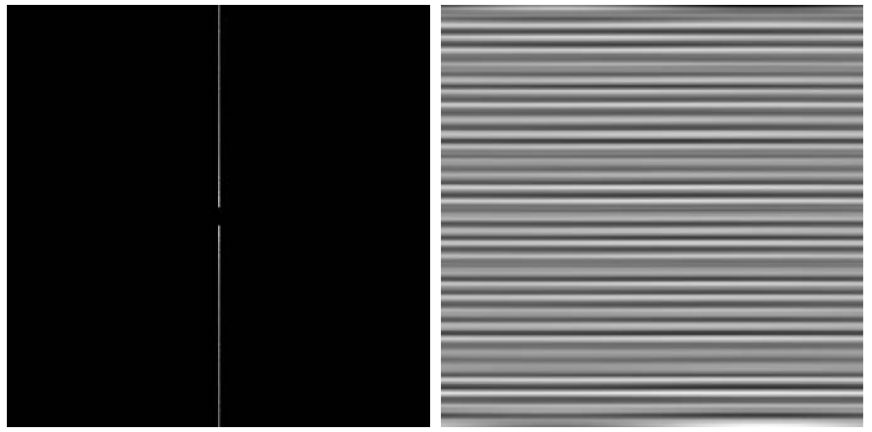
4.10.2 Enhancement of corrupted Cassini Saturn image by notch filtering
Figure 4.66
(a) Result (spectrum) of applying a notch pass filter to the DFT of Fig. 4.65(a).
(b) Spatial pattern obtained by computing the IDFT of (a).

Slide 102
4.11 Implementation
4.11.1 Separability of the 2-D DFT
(4.11-1)
where
(4.11-2)

Slide 103
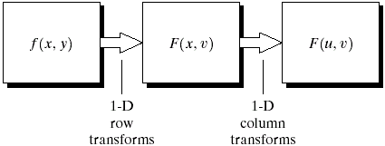
4.11 Implementation
4.11.1 Separability of the 2-D DFT
Figure 4.67
Computation of the 2-D Fourier transform as a series of 1-D transforms.

Slide 104
4.11 Implementation
4.11.2 Computing the IDFT Using a DFT Algorithm
(4.11-3)

Slide 105
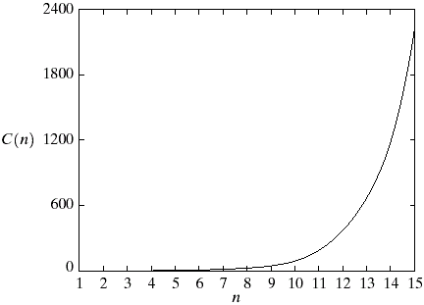
4.11 Implementation
4.11.3 The Fast Fourier Transform (FFT)
Figure 4.68
Computational advantage of the FFT over a direct implementation of the 1-D DFT. Note that the advantage increases rapidly as a function of n.

Slide 106
Thank you!

